Slide 1

Athena Software Group
Best in Class, AI Enabled, security solutions for Enterprise application providers.

Slide 2

01
Mission Statement
02
Market Opportunity
ASG Overview
03
Who we are and what we do
04
Products & Services
05
Leadership Team
06
Financial Model

Slide 3
Mission Statement
To provide enterprise application providers with a fully integrated and best in class set of tools for application security, availability and compliance.

Slide 4

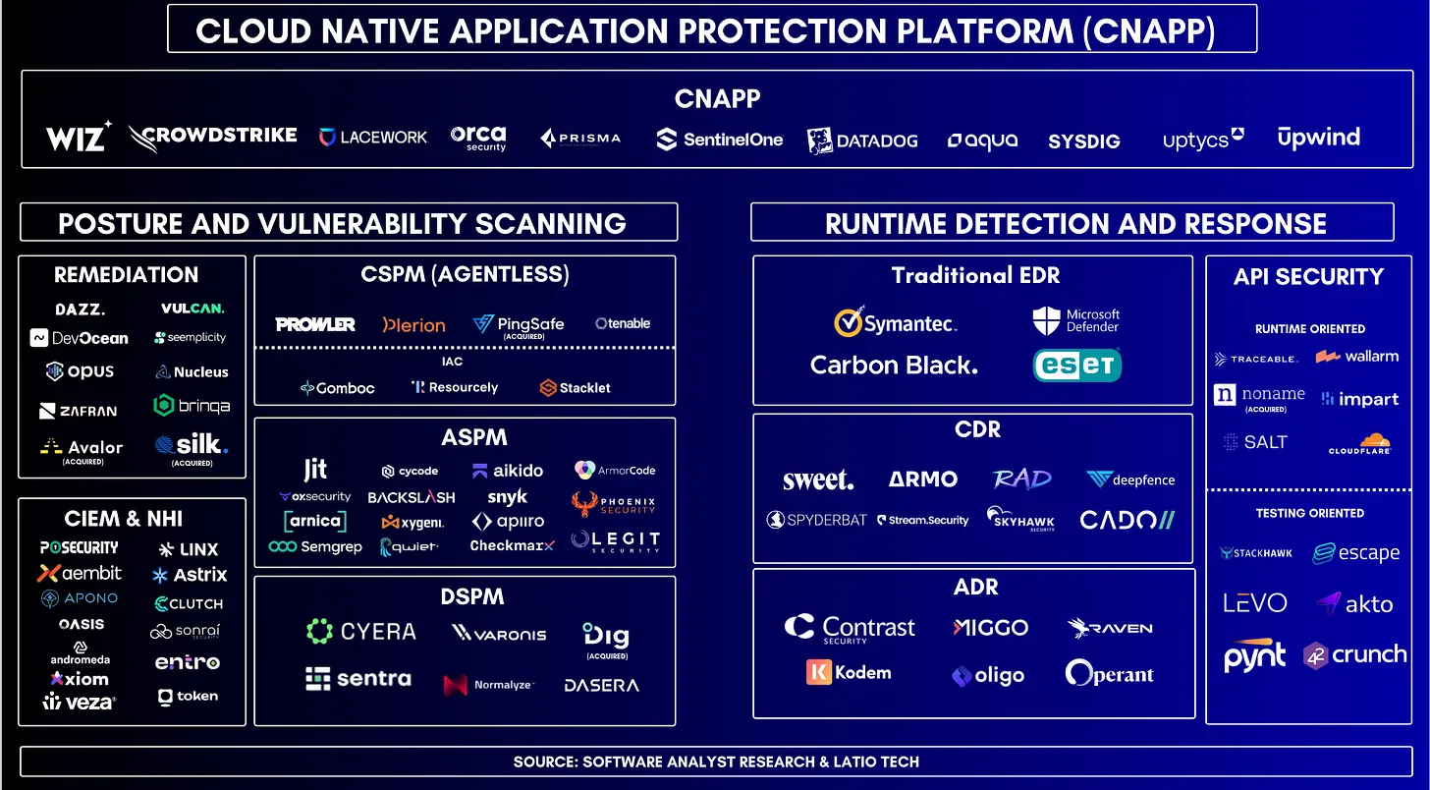
Cloud Solution Providers
If you’re not overwhelmed and confused, you’re not paying attention

Slide 5
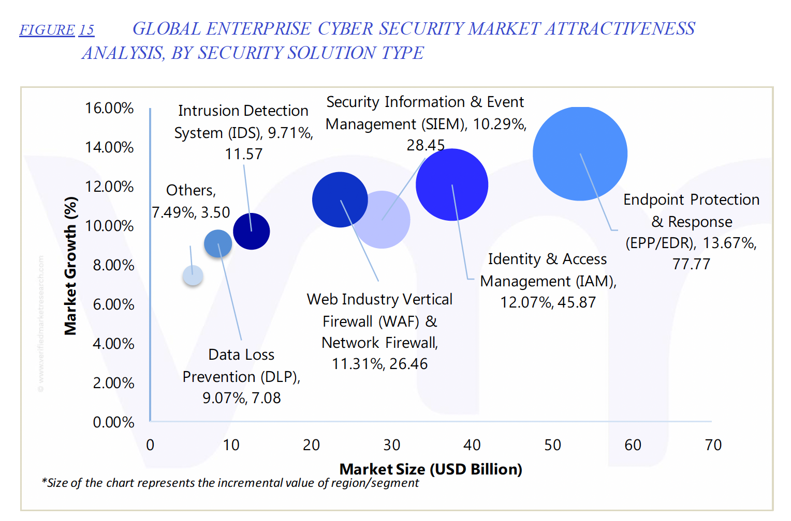
Fragmentation and Time to Resolution
Space is highly fragmented
ASP and MSPs have too many tools that are not integrated and most tools are not designed for ASPs
Cloud Providers have an assortment of tools that do not always play together
A single interface into the security and compliance status of an ASP is paramount to solving this problem at scale to minimize risk
Bad actors are well funded, driven by nation-states in many cases
Zero Days are becoming more problematic as the speed and velocity of threats accelerates. ASPs must be armed with near-real time information on threats, attack vectors and remediations continuously and in near-real time

Slide 6
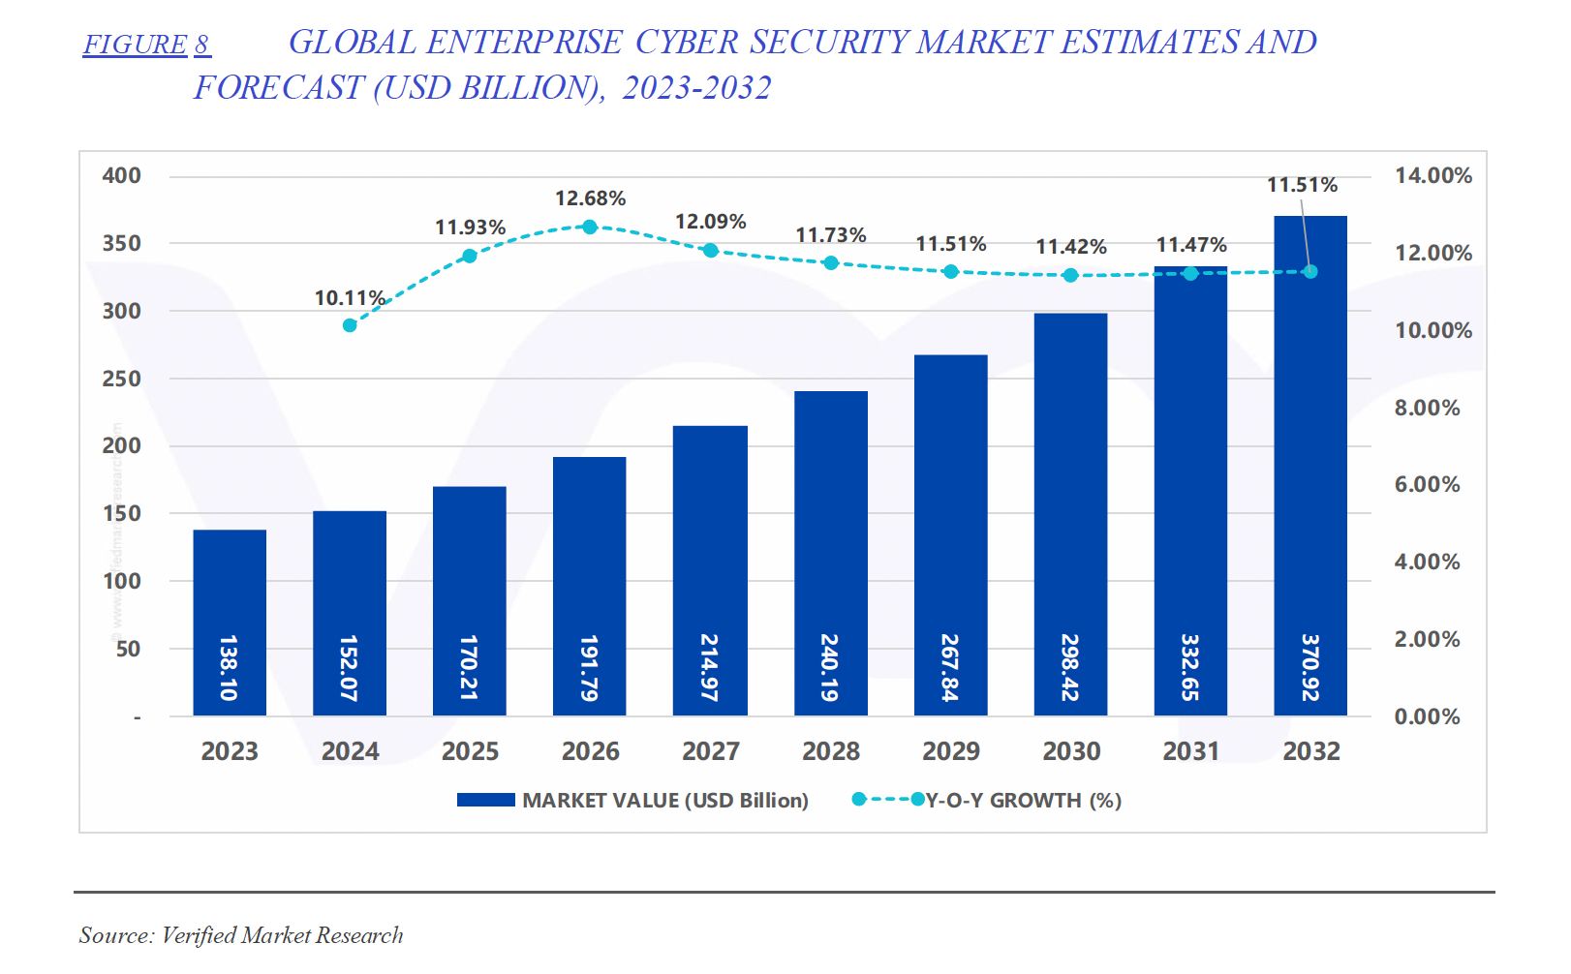
Market Opportunity
Cost of breaches continues to soar, as does Cyber Insurance costs, driving up spend on Cyber Security
LLM adoption in Cyber is just getting started. Bad actors are getting more sophisticated, leveraging AI technologies, platforms distribution models
Compliance continues to become more complex as the legislative landscape continues to evolve both in the US at the federal and state levels and in the EU, UK, ASPAC

Slide 7

Athena & ASG
Athena is the Greek goddess of wisdom, warfare, and strategic defense who represents, among other things, intelligence, foresight, and disciplined power. She is known for her tactical acumen, fairness, and ability to protect cities, notably Athens, which was named after her. Unlike Ares, who embodies chaotic war, Athena symbolizes calculated, strategic warfare and is often depicted with a shield (Aegis) and an owl, symbolizing vigilance and knowledge.
Strategic Defense & Threat Intelligence – Athena embodies proactive and intelligent defense strategies, much like modern security software that uses AI-driven analytics and predictive modeling to anticipate and neutralize threats before they materialize.
Wisdom & Adaptability – Just as Athena is known for her wisdom, security solutions must be adaptive and knowledge-driven, learning from past attacks to enhance resilience and provide smarter, automated security decisions.
Guardian of Digital Cities – In the same way Athena protected Athens, security software acts as the guardian of digital infrastructures, ensuring safety against cyber threats through firewalls, encryption, and intrusion detection systems.
Ethical & Fair Protection – Unlike brute-force approaches, Athena's wisdom-driven tactics align with ethical hacking, penetration testing, and responsible AI security measures that protect organizations without unnecessary aggression.
Athena Security Group is inspired by Athena and emphasizes intelligent, proactive, and ethical defense strategies, positioning itself as a guardian of digital landscapes, combining AI-driven foresight with robust protective measures.

Slide 8
Who we are what we do
Athena Software Group brings together some of the best minds in computer science, cyber defense and SaaS to design solutions specifically for application service providers to provide a single, integrated, intuitive cyber defense system that spans the entire application, system and network ecosystem within which the application resides, facilitating better, faster and more informed outcomes with respect to threat and anomaly detection, response management, vulnerability management and compliance.

Slide 9

Athena the Product
ASG
Network Intrusion Detection & Response (NIDR)
WAF & Firewall
System Incident Monitoring & Remediation (SIEM)
Vulnerability Management & Response
Application Performance Monitoring
Dashboard & Analytics
Global Threat Intelligence
Security Language Model
Legal & Compliance
Athena Software Group was founded with the vision that it should not be complicated to setup and maintain a best in class Cyber security posture for an enterprise application. The idea originates from the experience of one of the founders in building and supporting large scale, secure SaaS application infrastructures that house protected data for over two decades.
Most security software solutions are targeted at the entire corporate network infrastructure and as such CISO’s and Security Operations professionals who are responsible for maintaining the security posture of ASPs are left with the task of cobbling together a variety of tools across the observability, telemetry, IDS, SIEM, WAF and performance monitoring landscape to gain full visibility into their environment and detect and prevent threats.
This problem is further exacerbated with the deluge of information in the form of reports, email alerts and SIEM data that comes from these disparate providers, creating a complex and noisy monitoring and alerting environment where the discernment of critical information itself becomes a challenge, affecting incident response times which is the most critical metric in determining the extent and scope, and ultimately cost, of a data breach.

Slide 10
Our Services
Core Cyber Security Tools (Promachos)
Threat Intelligence Model (Glaukopis)
Cyber Product Development & Operations Support
Subscription fees, sized according to application complexity & scale
Custom Threat Intelligence LLM, license model channel dependent
Outsourced cyber security related product and/or operational support. Priced per project.

Slide 11
Product Roadmap & Go to Market Timeline
2025
2026
2027
2028
ALPHA
BETA
GAMMA
Delta
Entity & Team Build.
Site setup and Branding
Proof of Concept
Go to Market Strategy
Funding
Beta Release
Production Operations
Design Partners & Solution Delivery
Product Refinement & optimization
GA
SOC Operations & outsourcing
Partner Channels
Sales & Marketing Scale Additional Funding, Valuation
Market Disruption
Generation II LLM
Larger Customer Deployments
Custom Engagements
Release Early & Often
Engage Design Partners Early for market fit and revenue alignment
Raise funds only as necessary
Notes:
https://pixabay.com/en/entrepreneur-startup-start-up-man-593377/

Slide 12

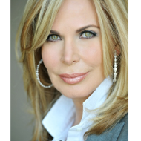
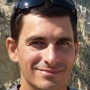
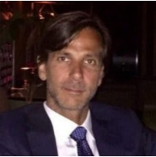
Our Leadership Team
Peter J Worth Jr
Michelle Robson Worth
Dr. Ionut Cardei
John Graziadie, Esq
Founder, CEO
Founder, CMO
Chief Scientist
Chief Legal Counsel
For almost two decades, Peter ran Technology and Security Operation for one of the nation’s leading Insurance Brokerage providers, serving many of the world’s largest and most heavily regulated organizations. Prior to joining ABC, Peter held senior leadership roles at Aria Systems, Taleo, CoreCentive and Portal Software, helping to design and build the Cloud and SaaS software infrastructure that has become the de facto standard for application providers today.
Michelle Robson Worth is a successful entrepreneur and advocate for women’s health, founding EmpowHER.com in 2008 and SkinSAFE in 2015, establishing tools and resources for women to take control of their health & wellness. In addition to her entrepreneurial activities, Michelle actively participates in philanthropy and advocacy for women's health issues around the world and brings with her a wealth of experience in building successful platforms that drive social change.
Dr. Ionut Cardei is a distinguished Professor and researcher in the Department of Electrical Engineering and Computer Science at Florida Atlantic University (FAU) and has published meaningful research in the area of wireless networking, graph theory, resource management and fault tolerant systems. Before joining FAU, Dr. Cardei was a Senior Research Scientist at Honeywell Labs in Minneapolis working with NASA and the FAA on dynamic policy management systems and aeronautical wireless networks and is currently the leader of the Athena Cyber Security lab at FAU in their Boca Raton Campus.
A graduate of the University of Virginia School of Law, John has been practicing in New York and Italy for over twenty-five years. John has held senior leadership positions in both the private and public sector in New York, representing both the city of New York City as well as some of the most well know brands in the world from an IP perspective. He earned his Masters in Intellectual Property Law at L'Università di Torino and also served as External General Counsel for a healthcare technology company where he practiced and managed the full spectrum of business law.
Notes:
Source File;-
https://unsplash.com/photos/PK_t0Lrh7MM
https://unsplash.com/photos/DItYlc26zVI
https://unsplash.com/photos/y9L5-wmifaY
https://unsplash.com/photos/MQ9U2GFnnDc

Slide 13
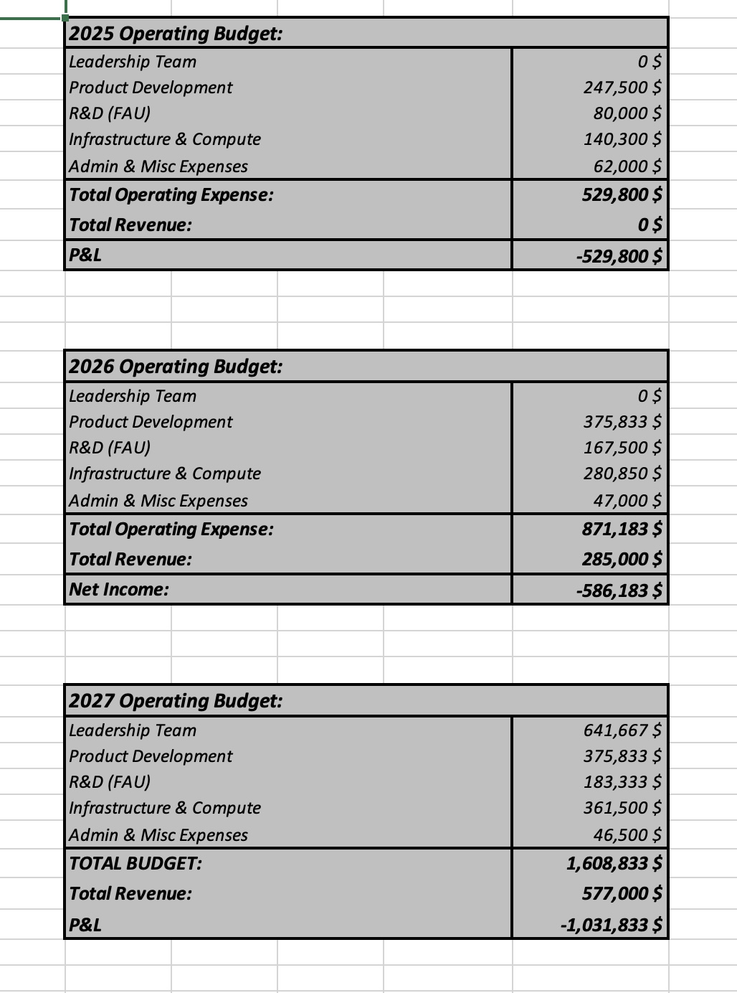
Financial Model (3 Year)

Slide 14

Athena Software Group
Best in Class, AI Enabled, security solutions for Enterprise application providers.

